Slide 1

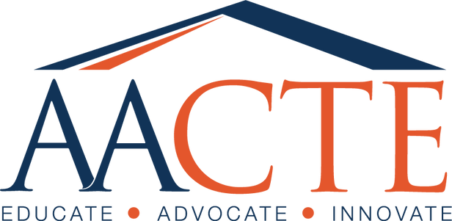
ConnectEd to Lead: Reflecting on the AACTE 2026 Conference and Beyond
March 30, 2026
Notes:
Open strong. Frame this as leadership, not lobbying. “This is not about reacting to policy. It’s about shaping it.”

Slide 2
Building the National Infrastructure: Shared History
AACTE established in 1948, unifying educator preparation leadership
National accreditation advanced with the founding of NCATE in 1954, a coalition effort including AACTE and other partners
AASCU founded in 1961 to represent state colleges and universities
TECSCU emerges in the 1970s, organizing education deans at state colleges/universities nationwide
CAEP formed in 2013, strengthening unified accreditation
AACTE celebrated 75 years as the national voice for educator preparation in 2023
ConnectEd to Lead and a $2.5B Federal Call to Action launch in 2026
TECSCU endorses AACTE Call to Action and serves as a national coalition leader rebuilding the educator workforce

Slide 3
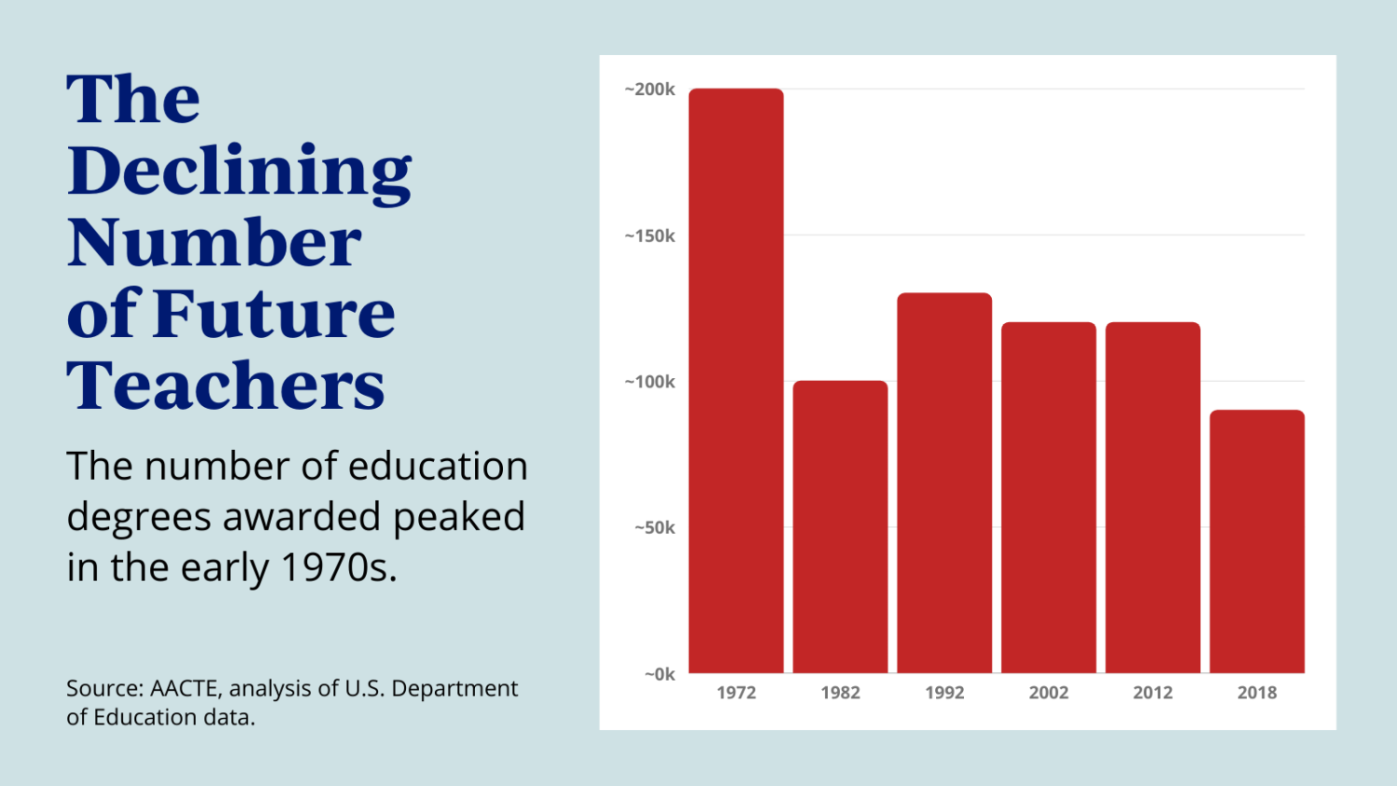
There is an educator shortage, particularly in high-need specialties such as STEM, special education, and foreign language education.
Declining Number of Future Teachers
Key Drivers
Lack of interest in education career
due to
* Compensation
* Work environment/Workload
* Public underappreciation
Retention of existing teachers and educators
Affordability and accessibility
Supports (e.g., professional
development, childcare, coaching)
Notes:
But as I’m sure you will agree. We have a problem that needs to be solved. There is an educator shortage, particularly in high-need specialties. For our nation to continue to prosper, we need excellent teachers, counselors, administrators, and school personnel. The key drivers of the teacher shortage are students and citizens' lack of interest in education careers due to compensation, work environment, public underappreciation
Other drivers include retention (or teacher attrition), affordability, and accessibility. We have recently learned that teachers and educators need high-quality professional development, childcare, and coaching.

Slide 4
Stronger Together: Dismantling Silos in Educator Preparation
PK-12 School Districts
Community
Colleges
Policy Agencies (Local, State, Federal)
Educator Preparation Ecosystem
Colleges/
Schools of Education
State Education Departments
Non-Profit Education Organizations
Alternative Certification Programs
Notes:
An aspect of our work that we could leverage for change is to eliminate the siloed nature of our educator preparation ecosystem. Colleges and Schools of Education are just one part of the system. If we worked together, we could ensure that students have seamless training experiences with clinical sites and guaranteed jobs. Our partnership is really important because we can convene these groups to respond to the educator shortage by creating policies, training, and placement opportunities for aspiring teachers.
Some in the workforce development arena view the teacher shortage via the lens of needing to bring these parts together for seamless transitions across these areas.

Slide 5
State and District-Level Educator Pipelines (Stackable Credentialing)
4
Job Placement/Coaching
3
BA/BS Degree
Guaranteed placement w/coaching and induction support for the first 5 years of education career.
Provide support for 4-year education students/teacher candidates; training that is accessible and affordable; include transfer students from community colleges and other learning settings
2
CDA/AA Degree
1
Dual Enrollment
Offer opportunity to gain teaching credentials to aspiring educators in community college and other alternative
settings while they work
Engage with high school students and offer education coursework for college credit
Stackable Credentialing (Work and Learn)
Supports (e.g., financial, academic, childcare) and Multiple Learning Modalities

Slide 6
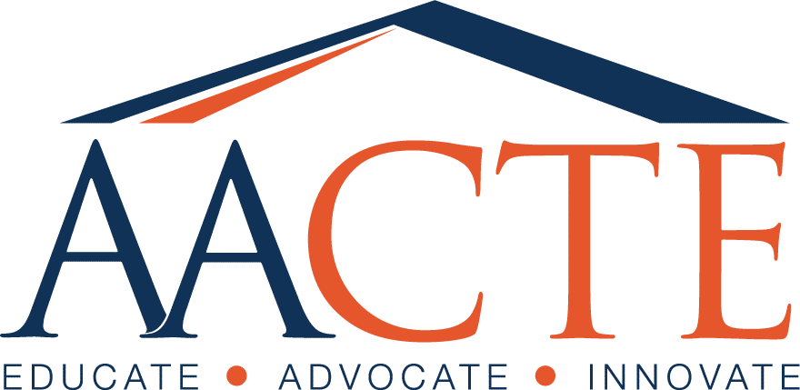
The Future of AACTE
Subtitle
Expand Memberships
Expand memberships to possibly include student memberships (with student services (e.g., coaching, exam preparation)
Create New Partnerships
Create new partnerships with non-profit organizations, corporations, and other entities that can expand educator preparation programming and scope.
Conduct New Knowledge
Conduct and disseminate research and innovations in educator preparation via external funding from the federal government and private foundations for work in specific areas related to AACTE’s mission and strategic plan.
Provide Supports
Provide supports and tools for institutional members and students who aspire to have careers in education.
Advocate and Lead
Advocate for education-based policies and practices and lead the campaign for those policies to be executed

Slide 7
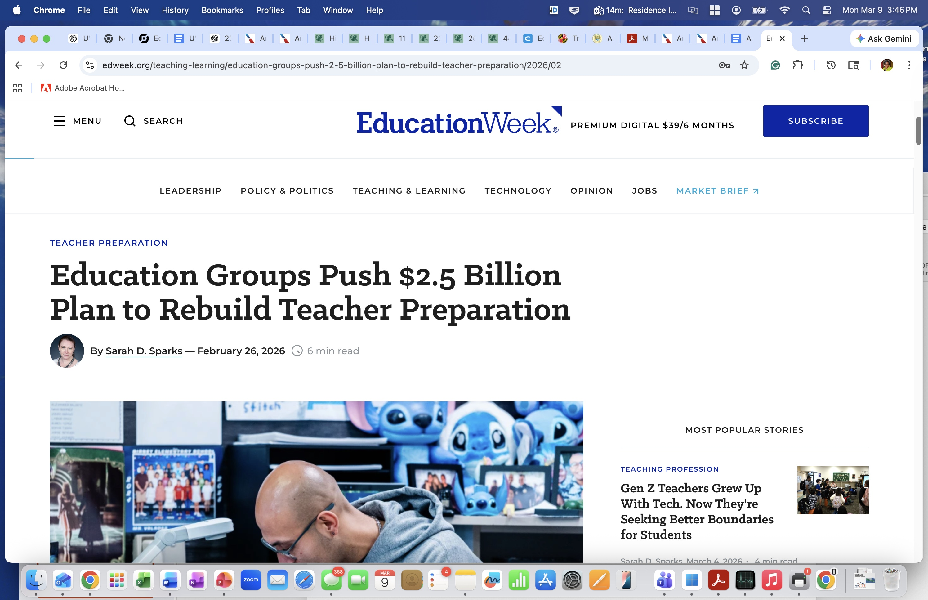
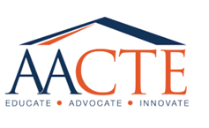
AACTE Call to Action
$2.5B national investment to rebuild and modernize the educator workforce

Slide 8
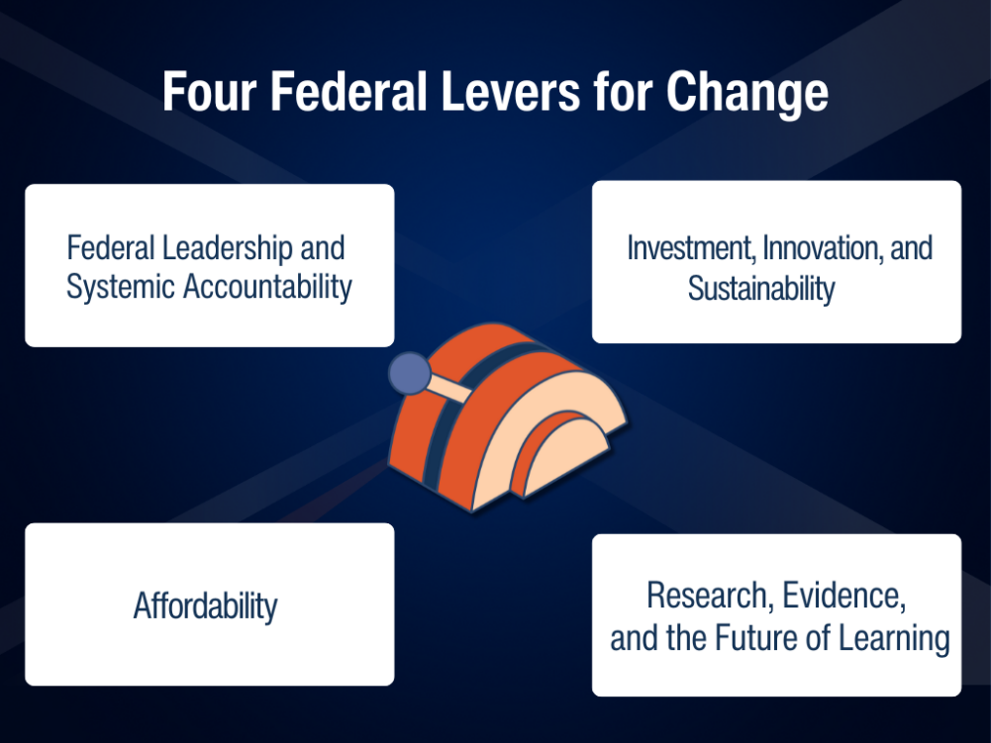
Notes:
We've identified 4 levers for change that can anchor the federal response and rebuild the educator workforce

Slide 9
Rebuilding the Educator Workforce: AACTE’s Federal Call to Action
A $2B+ Federal Strategy to Strengthen Teacher Preparation at Scale
1. Federal Leadership & Accountability
-National coordination via Office of Educator Workforce -Outcomes-based accountability

Slide 10
Rebuilding the Educator Workforce: AACTE’s Federal Call to Action
A $2B+ Federal Strategy to Strengthen Teacher Preparation at Scale
1. Federal Leadership & Accountability | 2. Investment, Innovation & Sustainability
National coordination Office of Educator Workforce Outcomes-based accountability | ~$2B+ investment Teacher Residencies, clinical models, AI-powered teacher tools need sustained funding

Slide 11
Rebuilding the Educator Workforce: AACTE’s Federal Call to Action
A $2B+ Federal Strategy to Strengthen Teacher Preparation at Scale
1. Federal Leadership & Accountability | 2. Investment, Innovation & Sustainability | 3. Affordability & Access
National coordination Office of Educator Workforce Outcomes-based accountability | ~$2B+ investment Residencies, clinical models, AI Sustained funding | -Reduce cost barriers via scholarships & stipends like in medicine -Diversify pipeline

Slide 12
Rebuilding the Educator Workforce: AACTE’s Federal Call to Action
A $2B+ Federal Strategy to Strengthen Teacher Preparation at Scale
1. Federal Leadership & Accountability | 2. Investment, Innovation & Sustainability | 3. Affordability & Access | 4. Research, Evidence & Future Readiness
National coordination Office of Educator Workforce Outcomes-based accountability | ~$2B+ investment Residencies, clinical models, AI Sustained funding | -Reduce cost barriers via scholarships & stipends (e.g.,childcare vouchers, revisit Teach Grant) -Diversify pipeline | -National data system -Research center -Future-focused innovation

Slide 13
Endorsing Partner Organizations
ACTFL
American Association of School Personnel Administrators (AASPA)
American Federation of Teachers (AFT)
Association of Independent Liberal Arts Colleges for Teacher Education (AILACTE)
American Educational Research Association
(AERA)
City Teaching Alliance
Council for Exceptional Children (CEC)
Deans for Impact
EdTrust
InnovateEDU
ISTE+ASCD
National Association for Family, School, and Community Engagement (NAFSCE)
National Education Association (NEA)
National Center for Teacher Residencies (NCTR)
Teacher Education Council of State Colleges and Universities (TECSCU)

Slide 14
Education Leaders: Strategic Leadership Recommendations
Prioritize Stackable Pipelines: Move beyond traditional recruitment; engage high schoolers and offer credit for work-based learning to other interested groups (e.g., paraprofessionals)
Dismantle Silos: Formally partner with community colleges and PK-12 districts to create a unified 'ecosystem’.
Focus on the 5-Year Window: Transition from recruitment to long-term retention through guaranteed coaching and induction support.
Advocate for the $2.5B Investment: Use local and state platforms to push for the federal modernization of the educator workforce.
To reverse the decline, leaders must be active architects of the
educator pipeline design.

